Slide 1
CLASSIFICATION OF IP ADDRESSES
IPV4

Slide 2
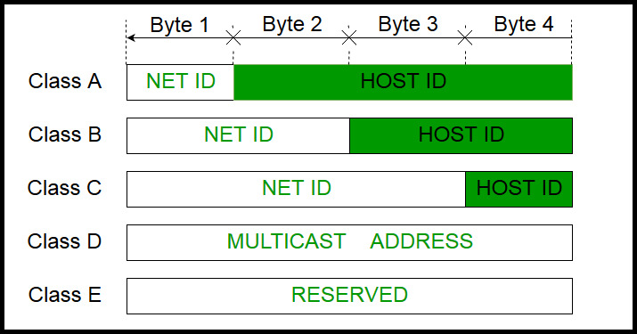

Slide 3
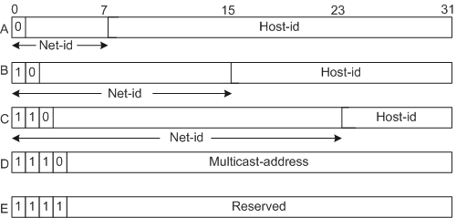

Slide 4
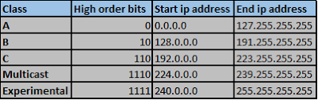

Slide 5
Static IP vs Dynamic IP

